Slide 1
Install Hadoop 3.3 on Windows 10

Slide 2
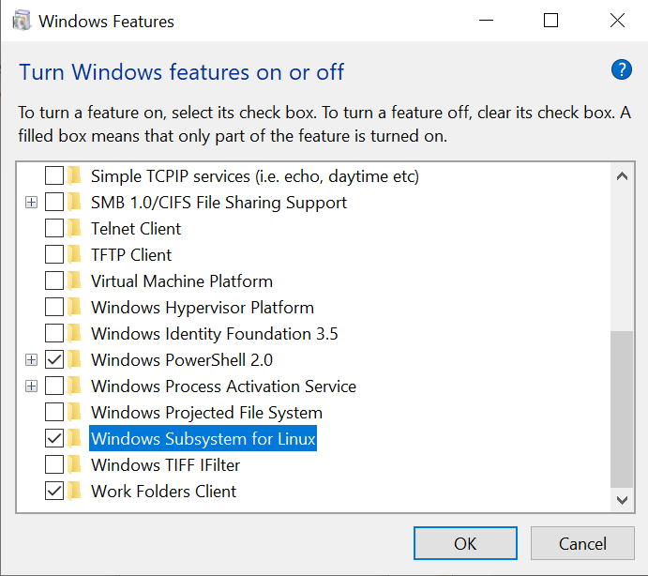
Enable Windows Subsystem for Linux

Slide 3
Open Microsoft Store and search for Linux
Download and Install Ubuntu
Launch Ubuntu and create a new account
Congrats! Now, you have a Linux system on your Windows!

Slide 4
Install Java 8
Run the fullowing command to install Java 8 (jdk1.8)
sudo apt-get update
sudo apt-get install openjdk-8-jdk
Note: must install version 8 (jdk1.8) as shown above

Slide 5
Download Hadoop
Run the following command to download
wget https://mirrors.ocf.berkeley.edu/apache/hadoop/common/hadoop-3.3.0/hadoop-3.3.0.tar.gz

Slide 6
Unzip Hadoop Binary
Run the following command to create a hadoop folder under user home folder:
mkdir ~/hadoop
And then run the following command to unzip the binary package:
tar -xvzf hadoop-3.3.0.tar.gz -C ~/hadoop
Once it is unpacked, change the current directory to the Hadoop folder:
cd ~/hadoop/hadoop-3.3.0/

Slide 7
Configure ssh
Make sure you can SSH to localhost in Ubuntu:
ssh localhost
If you cannot ssh to localhost without a passphrase, run the following command to initialize your private and public keys:
ssh-keygen -t rsa -P '' -f ~/.ssh/id_rsa
cat ~/.ssh/id_rsa.pub >> ~/.ssh/authorized_keys
chmod 0600 ~/.ssh/authorized_keys
If you encounter errors like ‘ssh: connect to host localhost port 22: Connection refused’, run the following commands:
sudo apt-get install ssh
sudo service ssh restart

Slide 8
Configure Hadoop
Add the following to ~/.bashrc
export JAVA_HOME=/usr/lib/jvm/java-1.8.0-openjdk-amd64
export HADOOP_HOME=~/hadoop/hadoop-3.3.0
export PATH=$PATH:$HADOOP_HOME/bin
export HADOOP_CONF_DIR=$HADOOP_HOME/etc/hadoop
Run the following command to source the latest variables:
source ~/.bashrc

Slide 9
Add the following to $HADOOP_HOME/etc/hadoop/hadoop-env.sh
export JAVA_HOME=/usr/lib/jvm/java-8-openjdk-amd64

Slide 10
Add the following configuration to $HADOOP_HOME/etc/hadoop/core-site.xml (i.e., use the following to replace empty <configuration> </configuration>
<configuration>
<property>
<name>fs.defaultFS</name>
<value>hdfs://localhost:9000</value>
</property>
</configuration>

Slide 11
Add the following configuration to $HADOOP_HOME/etc/hadoop/hdfs-site.xml (i.e., use the following to replace empty <configuration> </configuration>
<configuration>
<property>
<name>dfs.replication</name>
<value>1</value>
</property>
</configuration>

Slide 12
Add the following configuration to $HADOOP_HOME/etc/hadoop/mapred-site.xml (i.e., use the following to replace empty <configuration> </configuration>
<configuration>
<property>
<name>mapreduce.framework.name</name>
<value>yarn</value>
</property>
<property>
<name>mapreduce.application.classpath</name>
<value>$HADOOP_MAPRED_HOME/share/hadoop/mapreduce/*:$HADOOP_MAPRED_HOME/share/hadoop/mapreduce/lib/*</value>
</property>
</configuration>

Slide 13
Add the following configuration to $HADOOP_HOME/etc/hadoop/yarn-site.xml (i.e., use the following to replace empty <configuration> </configuration>
<configuration>
<property>
<name>yarn.nodemanager.aux-services</name>
<value>mapreduce_shuffle</value>
</property>
<property>
<name>yarn.nodemanager.env-whitelist</name>
<value>JAVA_HOME,HADOOP_COMMON_HOME,HADOOP_HDFS_HOME,HADOOP_CONF_DIR,CLASSPATH_PREPEND_DISTCACHE,HADOOP_YARN_HOME,HADOOP_MAPRED_HOME</value>
</property>
</configuration>

Slide 14
Format namenode
Run the following command
cd $HADOOP_HOME
bin/hdfs namenode –format
jps
After running jps, you should see something like:

Slide 15
Open the following URL in Browser
http://localhost:9870/dfshealth.html#tab-overview
You should see something like:

Slide 16
Run DFS Service
Run the following command
cd $HADOOP_HOME
sbin/start-dfs.sh

Slide 17
Stop the service
Run the following command
cd $HADOOP_HOME
sbin/stop-dfs.sh

